Slide 1

Absenteeism Predictive Model
Title of the Project
Nikhil Dongare
Gaurav Wani
Guide: S. Sindogi
ILMCV Factory

Slide 2
Problem Statement & Business Objective
Problem Statements
To Develop an AI based model for prediction of Absenteeism on shop floor
To have consistency in output with respect to process adherence/Safety and quality
Resource optimization
Better Employee Engagement
Objectives

Slide 3
Solution Methodology
Solution
Methodology
Technology Enablers
Realized Objectives
Collection of 10 years absenteeism data
Early identification of at Risk Individual
ARS software : SAP , Drishti
Bucketing of Data into Category / Event / Frequency / Duration
Proactive resource Management
Data Mining , Anaconda Navigator
Abstracting/ Processing of data from bucketing
Reduction of Unplanned Disruptions
Data Mining , Anaconda Navigator
Cost and Productivity optimization
Preparation of Structured & labelled data
Enhance organization policies
Choose suitable algorithms , Logistic regression , decision tree (AI Model selection)
Algorithms :
XGBOOST
Random Forest
Neural Network
Evaluate model performance using matrices
Deployment

Slide 4
Project Plan and Support Required
Project Plan
Support Required
Collection of Data
Interfacing SAP Data into usable formats
Two Weeks
Data Mining & Analysis
One Month
Platform / Software
Deriving Insights
One Week
IT Infrastructures
Structured & labelled data
One Week
Choosing of AI Model
One Week
AI Expert
Evaluation of AI Model Performance
Two Weeks
IT Support
Deployment
Two Weeks

Slide 5
Challenges
Due to restricted access to various software, we moved towards open-source available tools.
Due to complexity of available data our prediction accuracy use to get hampered so for that purpose we used a technique called "Hyper Parameter Tuning".

Slide 6
Collection of Data
Attendance data:
Collected previous 10 years of MOR data from SAP.
Data consisted of 35+ columns .
Each month have 900 to 1100 unique employees.
Thus for 10 years total rows of data is approx 3.4 million.
Holidays/Festivals data:
With the help of Calenderific API we fetched the data of holidays and festivals for India.

Slide 7

Data Mining & Analysis
Cleaned the attendance dataset by filtering and removing unwanted columns.
Created new columns to work with data.
Thus, bringing down the size of dataset to 21 million rows and 5 columns.
Cleaned the Holidays dataset by removing unwanted rows.

Slide 8
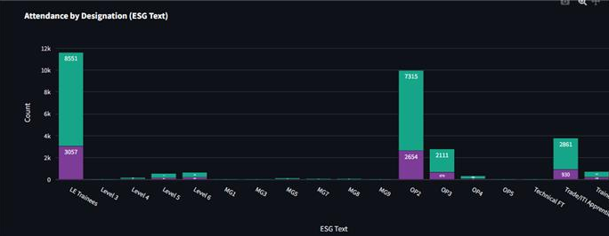
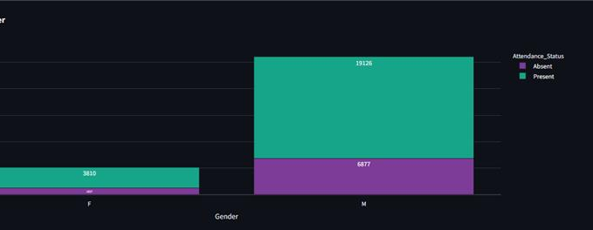
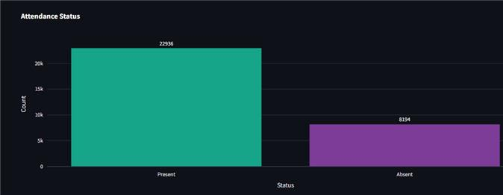
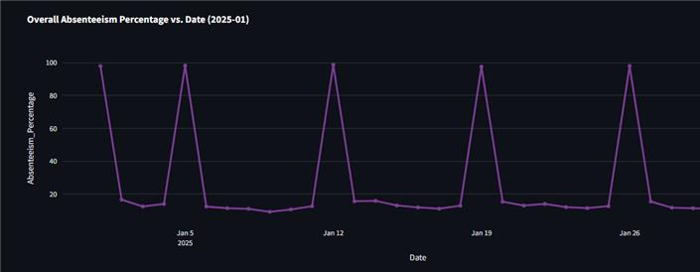
Deriving Insights
Visualized the trends of the dataset like General Absenteeism, Gender Wise Absenteeism and ESG level wise Absenteeism for particular month.

Slide 9
Structured & labelled data
Performed Feature Engineering to create new features with the help of existing data .
Merged holidays and attendance dataset and again performed feature Engineering.

Slide 10

Choosing of AI Model
Through Extensive Research on Internet , Multiple Research Papers and knowing the nature of the dataset we decided to use these three Algorithms to train our model.
Random Forest
XG-Boost
Neural Networks
After the training of model XG-Boost outperformed other algorithms.
Thus, final Choice is XG-Boost.

Slide 11
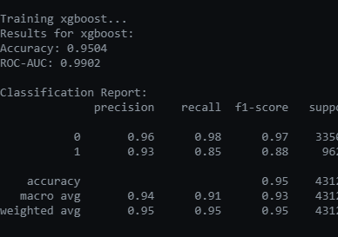
Evaluation of AI Model Performance

Slide 12
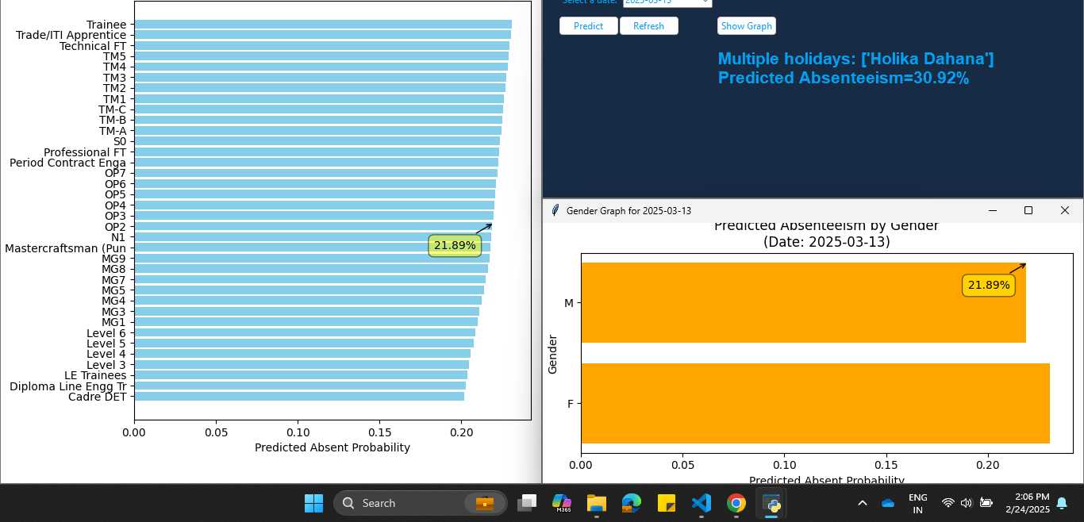
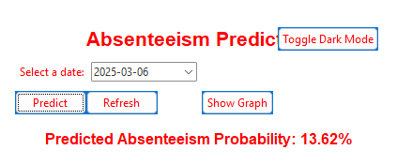
Previous Iterations of App

Slide 13
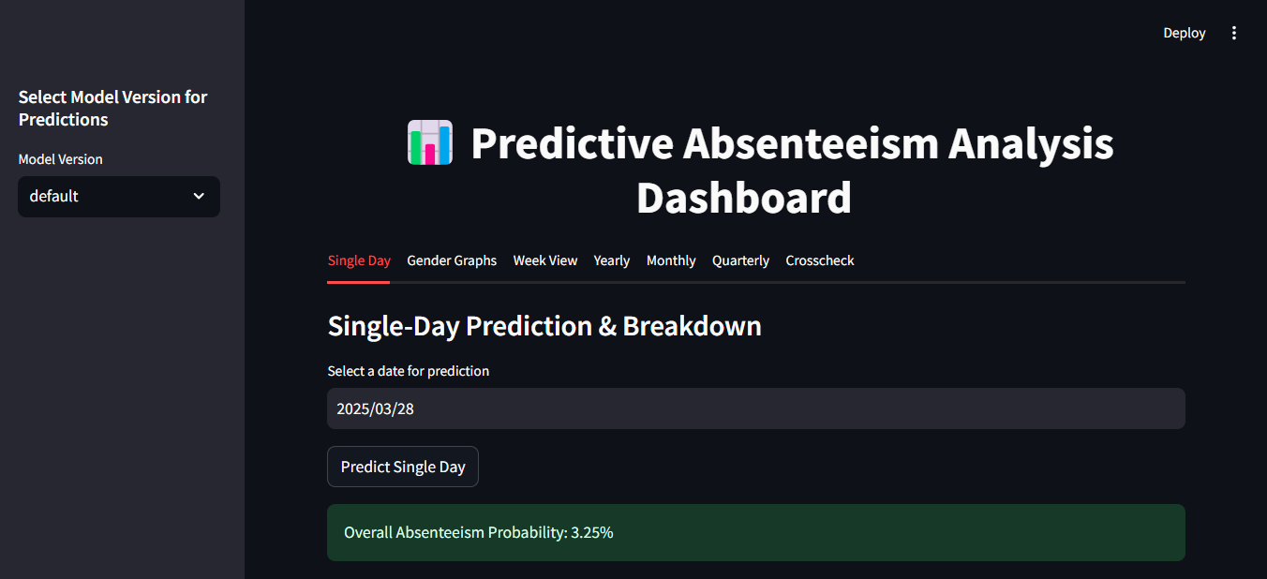

Slide 14
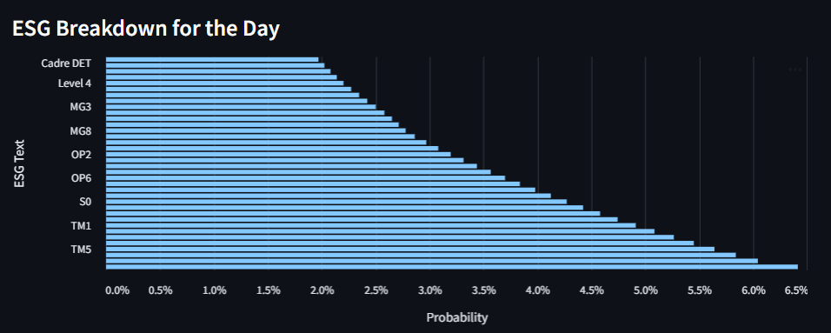

Slide 15
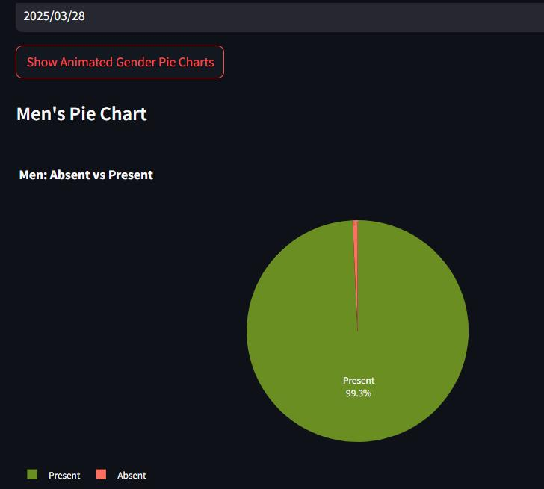
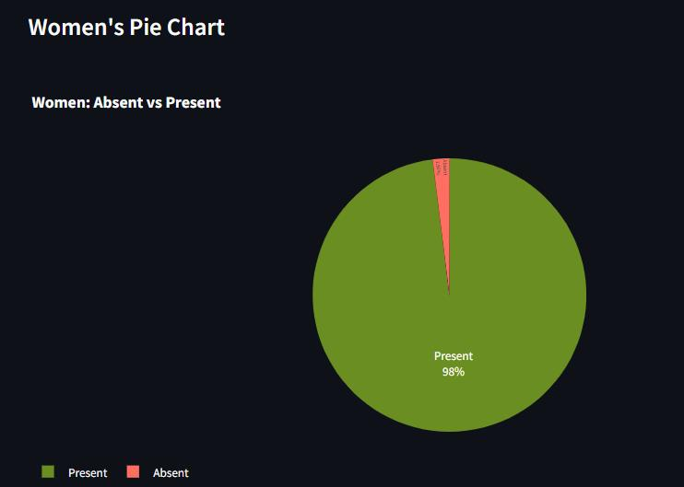

Slide 16
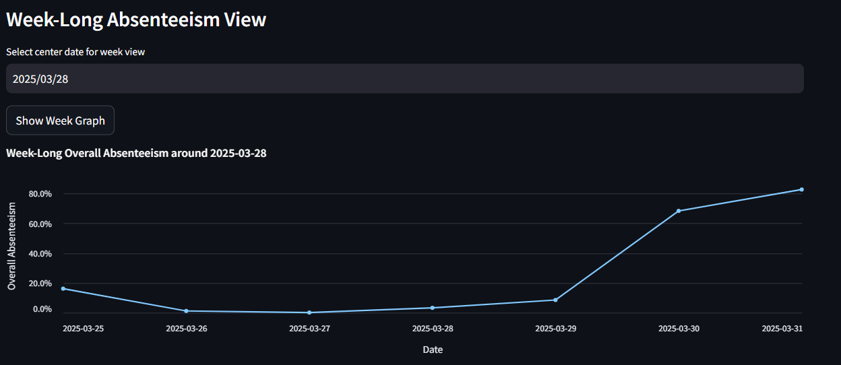

Slide 17
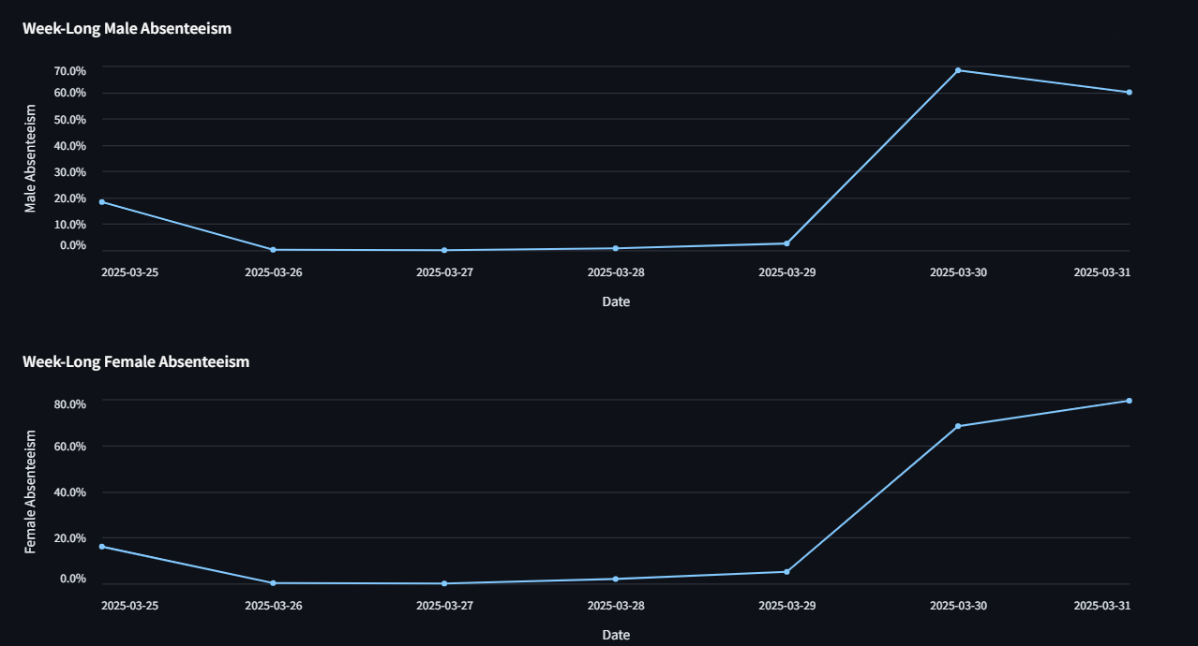

Slide 18
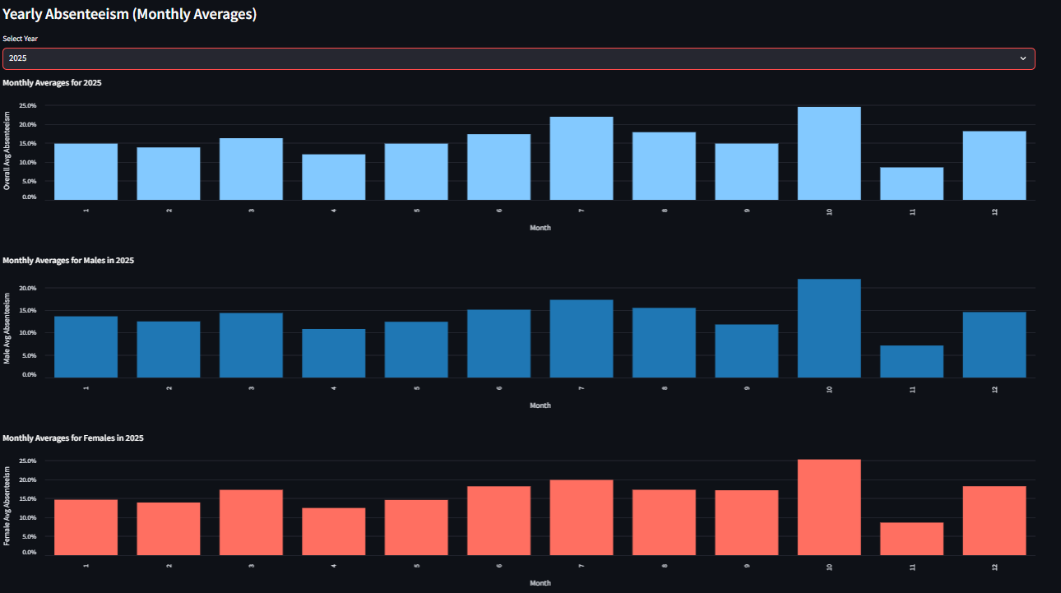

Slide 19

Future Scope
With Sufficient hardware power we can train the model with more data and more parameters like for all the shifts and different factories .
With the use of cloud platform this project can be more streamlined by integrating SAP data into a data pipeline format with dynamically pushing it to model development and getting desired output.

Slide 20
Thank You

